Slide 1
Super cashier pacmann
Samira al Zaitun

Slide 2


AGENDA
Background problem
Requirement code
Flowchart
Function / attribute explanation
Demonstration code and test code
Conclusion

Slide 3


Problem background
Benefits of Self-Service Cashier:
Efficient Transactions
Cost Reduction
Enhanced Customer Experience
Improved Data Analysis
Toko Nadim, Batam: Traditional face-to-face transactions
Adapting to the IoT era with an integrated app
Introducing the self-service cashier concept

Slide 4
REQUIREMENT CODE
Requirement :
Customer has ID transaction :
Each customer is assigned a unique transaction ID
Adding to Cart:
Selected items are added to the virtual shopping cart.
Updating and Checking Orders:
Easy updates to quantities or removal of items.
Review order details before checkout.
Order Cancellation:
Customers can request order cancellation.
Efficient handling and refunds or adjustments.
Accurate Total Calculation:
Total amount is calculated with high accuracy.
Discounts are applied based on applicable promotions.
Objective :
Customers can enter any kind of item that is available in the store and are able to update, check, or cancel it as needed.

Slide 5
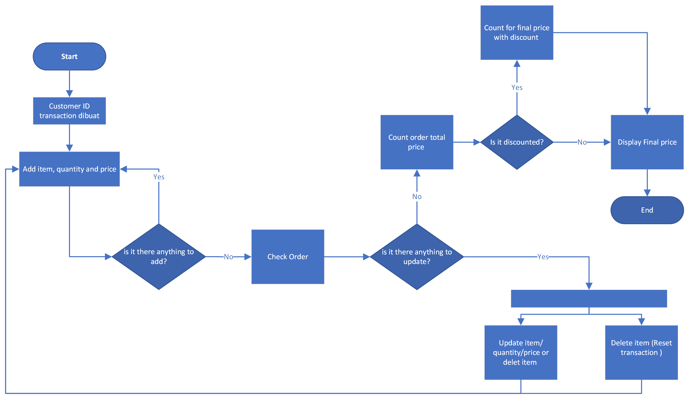
FLOWCHART

Slide 6
PROGRAM Function / attribute explanation

Slide 7
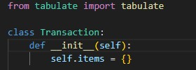
TABULATE & CLASS
The Transaction class has an __init__ method that initializes the class instance with empty dictionary items. This dictionary will be used to store the items and their details for the transaction.
Tabulate in order to generate the final result into the table

Slide 8
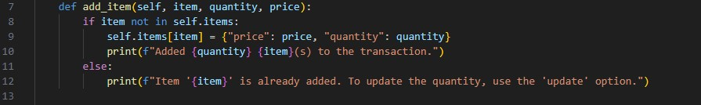
ADD ITEM
The add_item method adds shopping cart contain (item, quantity, and price per item) to the transaction by checking if the item is already present in the transaction's item list.

Slide 9
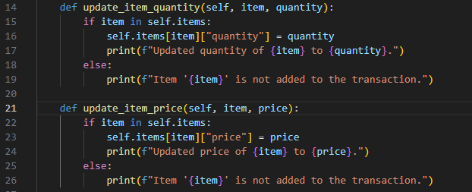
UPDATE
These methods (`update_item_quantity` and `update_item_price` update_item_price ) update the quantity or price of a specific item in the transaction.
They check if the item exists in the transaction's item list. If the item is found, they update the corresponding quantity or price with the new value provided.
If the item is not found, they display a message indicating that the item is not added to the transaction.

Slide 10
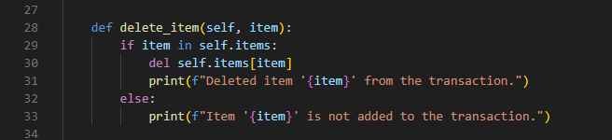
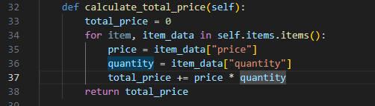
Delete item, calculate total price
The delete_ method is used to delete all items from the transaction.
It sets the item dictionary to an empty dictionary, effectively removing an items.
After deleting the item, it prints a message confirming that all items have been deleted.
The `calculate_total_price` method calculates the total price of the items in the transaction.
It multiplies the price by the quantity and adds it to the `total_price` variable.
This method provides a way to determine the overall cost of all items in the transaction..

Slide 11
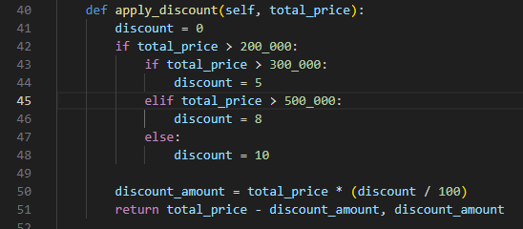
Apply discount
apply_discount(total_price)
Applies a discount based on the total price of the transaction.
Determines the applicable discount based on the total price thresholds. Calculates the discount amount and subtracts it from the total price. Returns the final price and the discount amount.

Slide 12
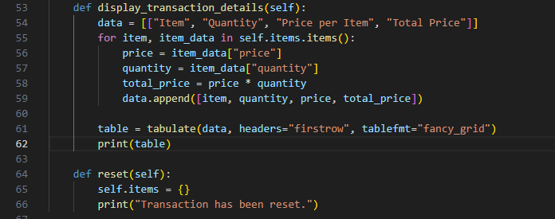
Check , reset
display_transaction_details()
Displays the details of the transaction in a formatted table.
Retrieves the item, quantity, price per item, and total price for each item in the transaction.
Creates a table with these details using the tabulate function. Prints the table to the console.
reset() / cancel
Resets the transaction by clearing all items.
Sets the items dictionary to an empty dictionary, effectively removing all items from the transaction. Prints a message indicating that the transaction has been reset.

Slide 13
Test program code

